Slide 1


Slide 2

B V V Sangha’s
BASAVESHWAR ENGINEERING COLLEGE
Bagalkote ,587102
Department of ARTIFICIAL INTELLIGENCE AND MACHINE LEARNING
Project Demo on :-
Player Role Classification in Cricket using ML models.
Team Members :-
Keerti Nandi (2BA22AI013)
Ibrahim Indikar (2BA22AI010)
Prashant R H (2BA22AI025)
Vivek S Hosur (2BA22AI052)
Project Guide Project Coordinator Head of Department
(Dr. Bharati Reshmi ) (Prof. Lakshmi Kolur) (Dr. Anil Devangavi)

Slide 3
Contents
Introduction
Objectives
Literature Surveys
Problem Definition
Dataset Description
System Requirement Specifications
System Architecture and Proposed Methodology
Conclusion
Reference

Slide 4
Cricket is a dynamic sport where players contribute in distinct roles such as Batsman , Bowlers , All-rounders. Accurate classification of these roles is vital
for team selection, strategy development, and performance analysis.
With advancements in data analytics, machine learning (ML) offers a powerful approach to automate this classification process. By analyzing player statistics like batting averages, bowling economies, ML models can identify patterns and assign roles effectively.
Project focuses on developing a player role classification system using ML, aiming to assist in team optimization and data-driven decision-making in cricket.
Project also helps to make a balanced and perfect teams for the tournaments.
Introduction

Slide 5
Automate Role Identification: Develop a machine learning model to automatically detect and classify player roles based on performance metrics, game statistics,and positional data.
Improve Team Strategy: Provide accurate insights into player roles to help coaches and analysts optimize team composition and strategies.
Enhance Talent Scouting: Identify and categorize players skills and strengths for better recruitment and role assignment during talent scouting.
Facilitate Performance Analysis: Enable in-depth analysis of players contributions to the game, allowing for role-based performance reviews and improvements.
Objectives

Slide 6
Literature Surveys
Sl No . | Title | Authors | Publication Year | Description
1. | Cricket Player Role Prediction Using Random Forest | A. Kumar , S. Sharma | 2021 | Used Random Forest to predict cricket player roles (batsman, bowler, all-rounder) based on stats like batting average and bowling economy. Achieved 90% accuracy, highlighting the model's strength in handling high-dimensional data and feature importance ranking.

Slide 7
Sl No . | Title | Authors | Publication Year | Description
2. | Application of Random Forest for Sports Performance Prediction | T. Singh, R. Patel | 2019 | Applied Random Forest to predict football player performance, successfully identifying key features like passing accuracy and tackles. Demonstrated effectiveness in handling missing data and reducing overfitting.
3. | Predicting Player Roles in Team Sports Using Random Forest | M. Thomas, J. Collins | 2020 | Used Random Forest to predict basketball player roles, leveraging player statistics such as points scored and assists. The model's ability to handle categorical and numerical data led to strong performance and interpretability.

Slide 8
In cricket, accurately categorizing players into roles such as batsman, bowlers, all-rounders is critical for team strategy and performance optimization. Existing manual or semi-automated approaches are subjective, time-intensive, and struggle with dynamic player performance.
Key Challenges:
Performance Variability: Player contributions differ across match formats and conditions.
Data Imbalance: Underrepresented roles like wicketkeepers lead to biased classifications.
Hybrid Roles: Overlapping skill sets (e.g., batting all-rounders) complicate the process.
Problem Definition

Slide 9
The cricket player dataset contains 17,389 records(rows) and 17 columns, capturing detailed information about players.
Key features include personal details like name, date of birth, gender, as well as performance metrics such as runs scored, batting average, strike rate, best score, wickets taken, bowling average, strike rate, and best bowling figures.
The dataset is a mix of categorical and numerical data , Numerical fields like runs and wickets offer quantifiable metrics for player performances , while categorical fields such as gender and batting style classify players into distinct groups.
Dataset Description

Slide 10
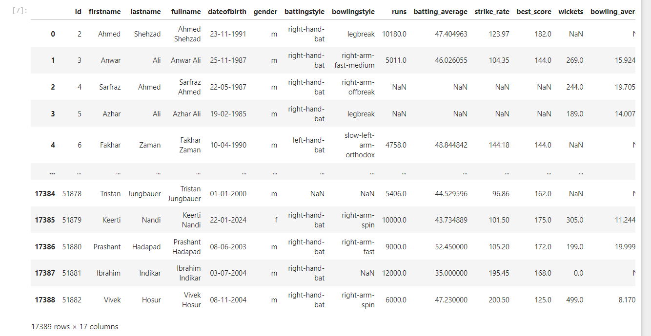

Slide 11


runs :- Runs are the points a batsman scores by hitting the ball and running between the wickets, or by hitting the ball to the boundary (4 or 6 runs).
batting_average :- Batting average is the number of runs a batsman has scored divided by the number of times they have been out.
strike_rate :- Strike rate is the average number of runs scored by batsman per 100 balls faced.
best_score :- Best score is the highest number of runs a batsman has scored in a single innings.

Slide 12


wickets :- is the dismissal of a batsman, either by bowling them out, catching them, or through other forms of dismissal like run outs.
bowling_average :- is the number of runs a bowler gives up per wicket taken.
bowling_strike_rate :- Bowling strike rate is the average number of balls a bowler needs to take a wicket.
best_bowling :- Best bowling is the best performance by a bowler in a single innings, measured by the most wickets taken in the fewest balls.

Slide 13
System Requirement Specifications
Hardware :-
Processor :- Intel i5 or above
RAM :- 8GB or higher
Disk Space :- Minimum 20GB
Software :-
Python (libraries : scikit-learn , pandas , matplotlib, etc)
Jupyter Notebook
OS :- Windows , MacOS, or Linux

Slide 14
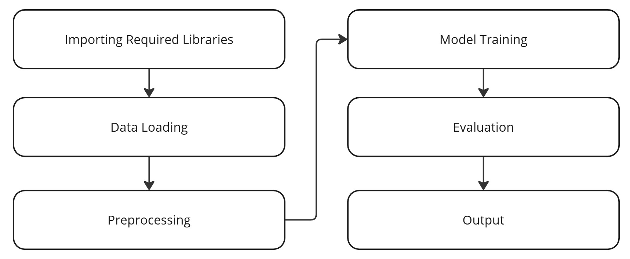
System Architecture

Slide 15
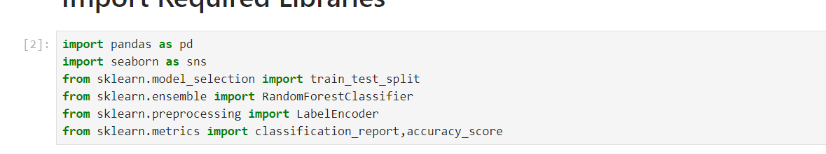
Code Snippet
Import Required Libraries :-
These libraries are critical for:
Handling and preparing the dataset (pandas and LabelEncoder).
Building and training the model (RandomForestClassifier).
Splitting data efficiently (train_test_split).
Generating detailed performance metrics (classification_report).

Slide 16
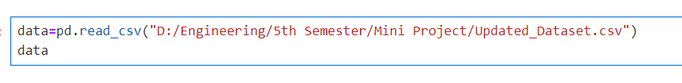
Data Loading:-
The cricket player dataset contains 17,389 records(rows) and 17 columns, capturing detailed information about players.
Key features include personal details like name, date of birth, gender, as well as performance metrics such as runs scored, batting average, strike rate, best score, wickets taken, bowling average, strike rate, and best bowling figures.
The dataset is a mix of categorical and numerical data , Numerical fields like runs and wickets offer quantifiable metrics for player performances , while categorical fields such as gender and batting style classify players into distinct groups.

Slide 17
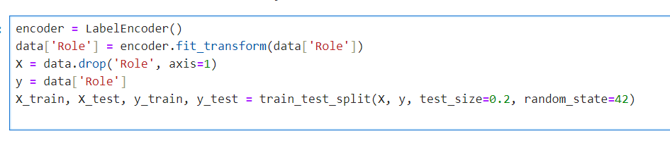
Data Preprocessing:-
Label_encoder :- The LabelEncoder converts the 'role' column, which contains categorical labels (e.g., 'batsman', 'bowler', 'all-rounder, into a numeric format suitable for machine learning algorithms. Each unique label gets assigned a corresponding integer.
train_test_split :- This code splits the dataset (X for features and y for target) into training and testing sets, with 80% of the data used for training (X_train, y_train) and 20% reserved for testing (X_test,y_test). The random_state=42 ensures reproducibility of the split.

Slide 18

Model Training:-
The chosen model, Random Forest Classifier, is a powerful ensemble learning technique that combines multiple decision trees to enhance classification accuracy and reduce overfitting. By setting `random_state=42`, the randomness in model initialization is controlled, ensuring that the results are reproducible in subsequent runs.
This approach is particularly suitable for player role classification because Random Forest can handle both numerical and categorical data efficiently. Additionally, it provides insights into feature importance, which helps highlight the most influential metrics for accurate role determination.

Slide 19
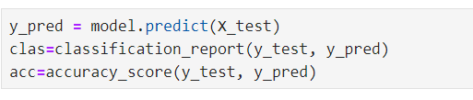
Model Evalution:-
.predict :- The predict() method is used to classify the test dataset (`X_test`) based on patterns learned during training. The output, y_pred contains the predicted roles for each player in the test set.
classification_report :- This generates a detailed evaluation report, including metrics like precision, recall, F1-score, and support for each class (e.g., batsman, bowler, all-rounder). These metrics help assess how well the model differentiates between roles.
accuracy_score :- This computes the overall accuracy, which is the proportion of correctly classified instances out of the total test samples. It provides a high-level measure of the model’s performance.

Slide 20
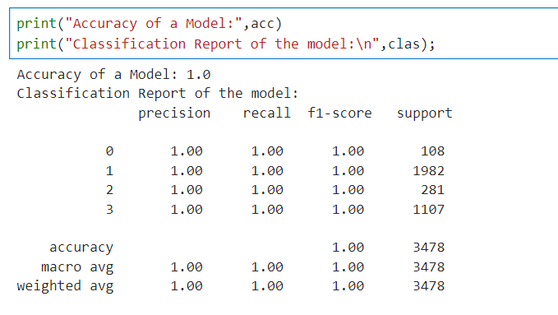
The model exhibits perfect accuracy and balanced performance across all classes. This suggests excellent performance on the dataset.
The support column indicates the number of samples for each class (e.g., 108 for class 0, 1982 for class 1). The "macro avg" represents the unweighted mean across all classes, while "weighted avg" takes into account the support of each class. These averages also reflect perfect scores, emphasizing that the model performed uniformly well across all classes. While the results are excellent, such high accuracy might suggest overfitting, especially if evaluated on training data instead of unseen data.

Slide 21
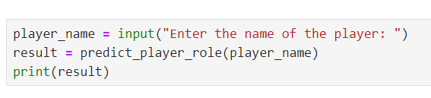

Output:-
The predict_player_role() function processes the input, retrieves the relevant player data from the dataset, and uses the trained Random Forest Classifier to predict the player's role. This showcases the practical application of the machine learning model in a real-world scenario.

Slide 22
Discussion
The Random Forest Classifier achieved 100% accuracy on the test dataset, demonstrating its exceptional ability to learn and classify complex patterns. The perfect metrics, including precision, recall, and F1-scores, across all roles (batsman, bowler, all-rounder, and unknown) indicate that the model is highly accurate with no false positives or false negatives.
Additionally, the feature importance analysis offers valuable insights into which performance metrics, such as batting average and strike rate, contribute most to role classification, enhancing the model's interpretability.
It also enhances talent scouting by identifying players suited for specific roles and aids coaches and analysts in tracking performance trends. Looking ahead, implementing cross-validation could improve the model's generalizability across different datasets, while integrating live match data would ensure the model reflects players' evolving performance.
Lastly, exploring advanced techniques like ensemble approaches or deep learning could help handle more complex relationships and improve classification of hybrid roles.

Slide 23
Conclusion
In this project, we used a Random Forest Classifier to predict and classify cricket players into distinct roles (batsman, bowler, all-rounder) based on performance metrics such as batting average, bowling economy rate, and strike rate.
The Random Forest model demonstrated high accuracy and robustness in handling diverse and large datasets, effectively identifying the most important features contributing to player classification.
This approach can significantly enhance team strategy and player performance analysis by providing deeper insights into player roles.
Provides a deeper understanding of players strengths and weaknesses, aiding in performance optimization.

Slide 24
References
A Survey of Machine Learning Algorithms in Sports Analytics - This paper explores how machine learning techniques are applied to various sports for player classification, performance analysis, and more. (https://www.sciencedirect.com/science/article/pii/S2405452620300299 )
Machine Learning Algorithms for Classification in Sports - A review of different machine learning algorithms used in sports analytics, which might be relevant for your project.(https://link.springer.com/chapter/10.1007/978-3-030-32038-1_18 )
Cricket Player Performance Prediction Using Machine Learning Algorithm – A Research paper that discusses various machine learning algorithm for cricket performance prediction. (https://www.researchgate.net/publication/332482727_Cricket_Player_Performance_Prediction_Using_Machine_Learning_Algorithms )

Slide 25


